Slide 1

KFC App Redesign
PRESENTATION
Presented by
SQUAD X TEAM

Slide 2

TEAM MEMBERS
ID
عبدالرحمن علاء مصطفى عطية
2023131
عادل عبدالظاهر عادل ابوزيد امين
ID
2023115
ID
احمد مجدي محمد ابوالمكارم حتاته
2023019
مريم ايمن احمد عبدالرحمن عبدالله
ID
2023205
ID
زينب ابراهيم سيد احمد قشقوش
2023097
ID
شهد صادق نعيم محمد شعير
2023112
Presented by
SQUAD X TEAM

Slide 3



problems
OLD DESIGN
1
2
3
4
Complex and Poor Layout
Poor Core Navigation
Outdated Visual Quality
Missing Core Elements
A critical lack of a primary Search function, obstructing quick product access and causing boredom.
Interfaces were overly complicated, lacking simple layouts, making the ordering journey confusing and leading to distraction.
Reliance on confusing side menus instead of a modern Bottom Navigation Bar.
Interface images appeared dull and outdated, failing to reflect the brand's modern identity.

Slide 4

Our Primary Goals for the Redesign
Enhance Usability
Integration of a Prominent Search Tab and a Bottom Navigation Bar.
solu
tions
Utilizing clean, comfortable layouts with increased white space for content organization.
Simplify the Interface
Modernize Visual Identity
Improving image and color quality to create a more appealing and appetizing interface.
Accelerate the User Journey
Consolidating and simplifying the sign-up process to ensure a higher order completion rate.

Slide 5
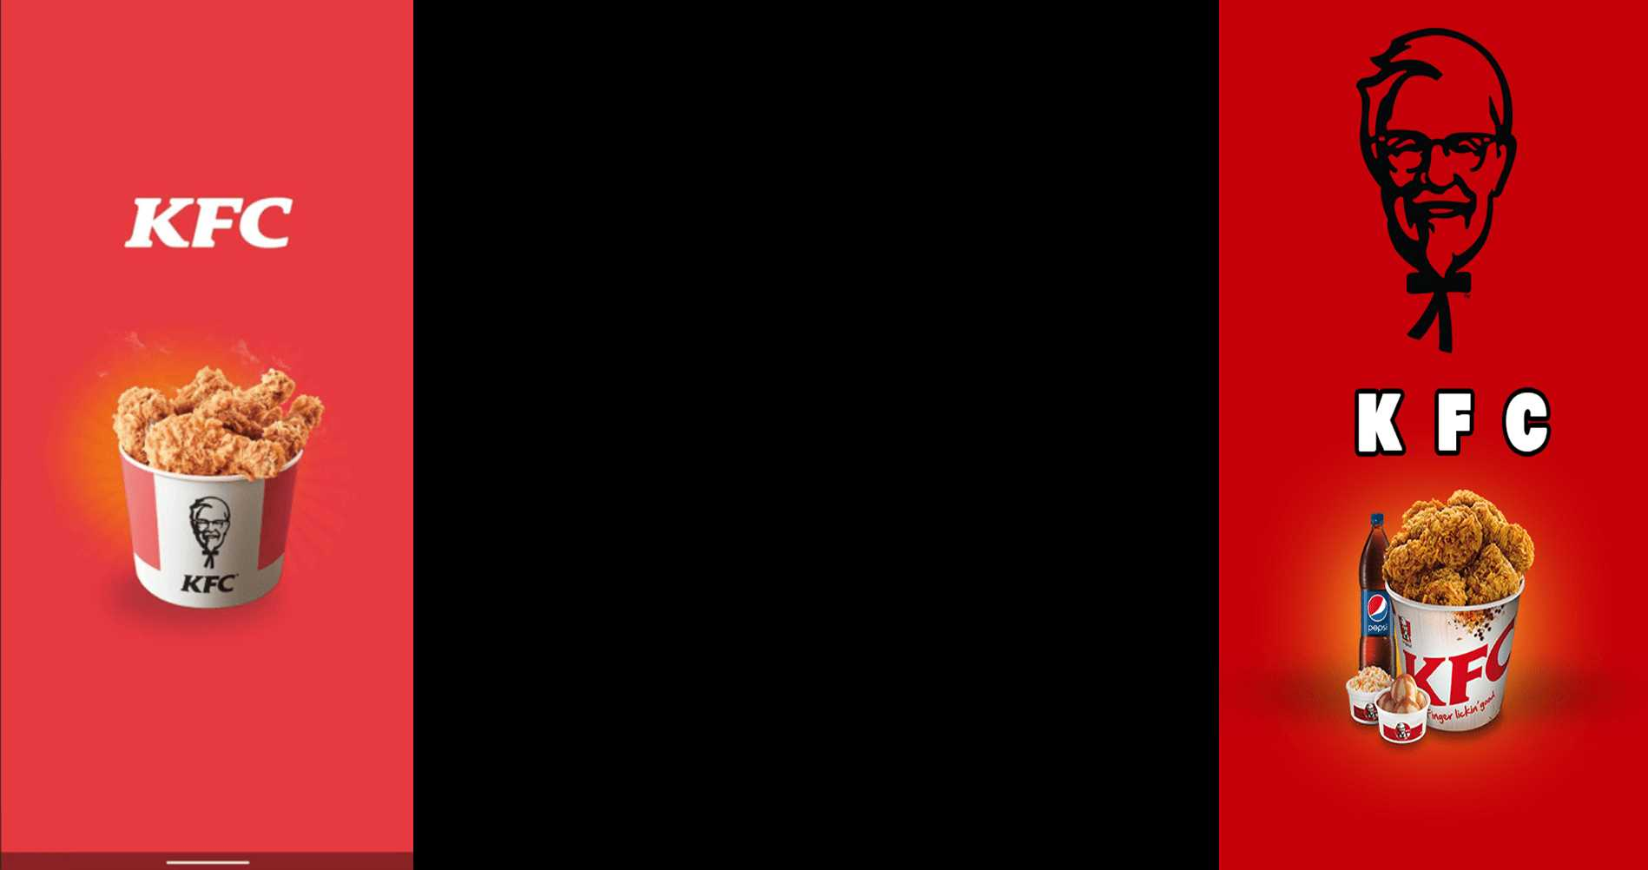



The old design used a lighter red with weak contrast, resulting in a flat appearance and a less engaging brand experience, especially on waiting screens.
The old design used a lighter red with weak contrast, resulting in a flat appearance and a less engaging brand experience, especially on waiting screens.

Slide 6
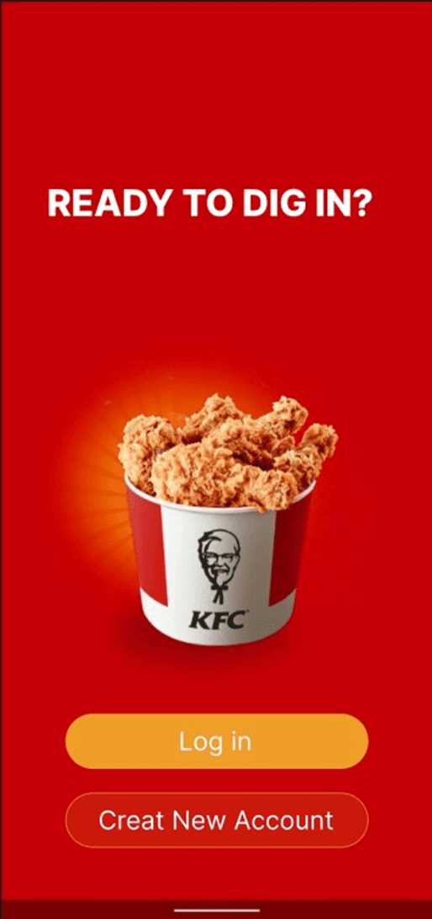
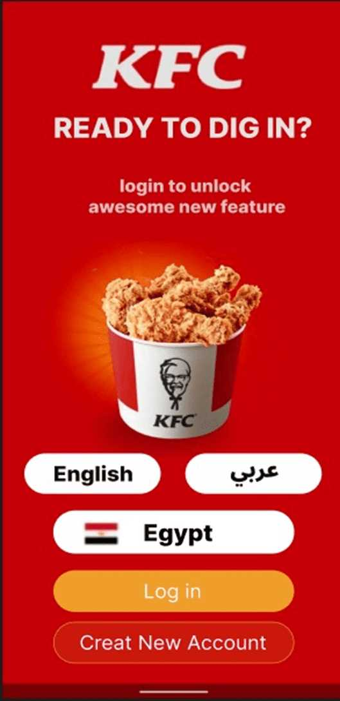
The old welcome screen was visually cluttered and uncomfortable, increasing cognitive load and negatively affecting overall usability.
The redesigned welcome screen features a cleaner and simpler layout with improved visual hierarchy. Language and location selection options were added to give users early control and personalization, resulting in a more intuitive, comfortable, and user-friendly first interaction.

Slide 7
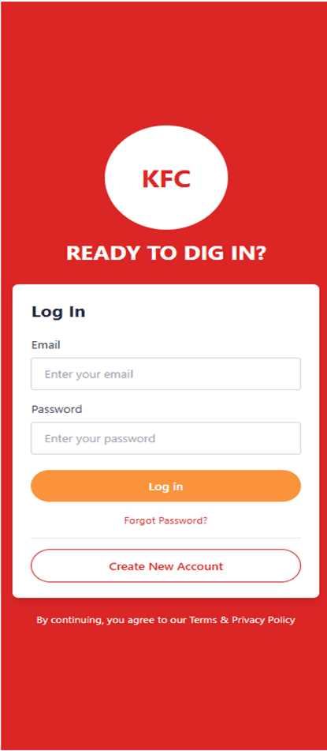
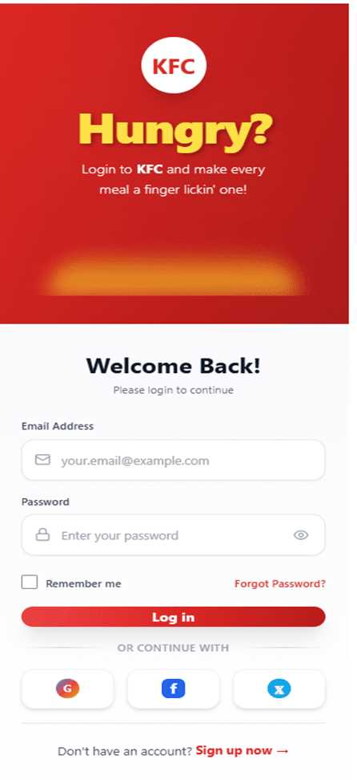
The old login screen used a basic layout with weak brand identity, limited user feedback, small touch targets, and no clear error prevention, which reduced overall mobile usability.
The redesigned login screen preserves the KFC theme while adding social login and a Remember Me option, with improved feedback and larger touch targets to enhance usability and reduce errors.

Slide 8
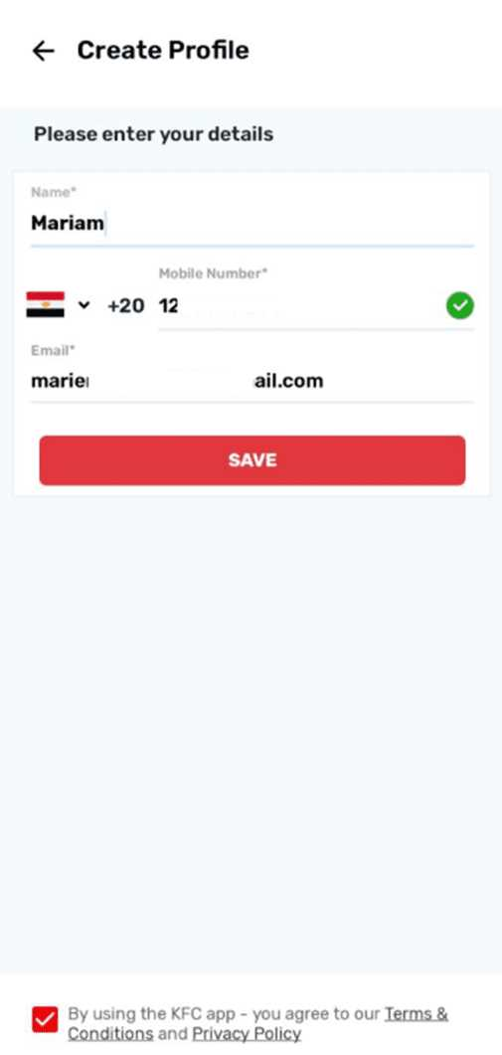
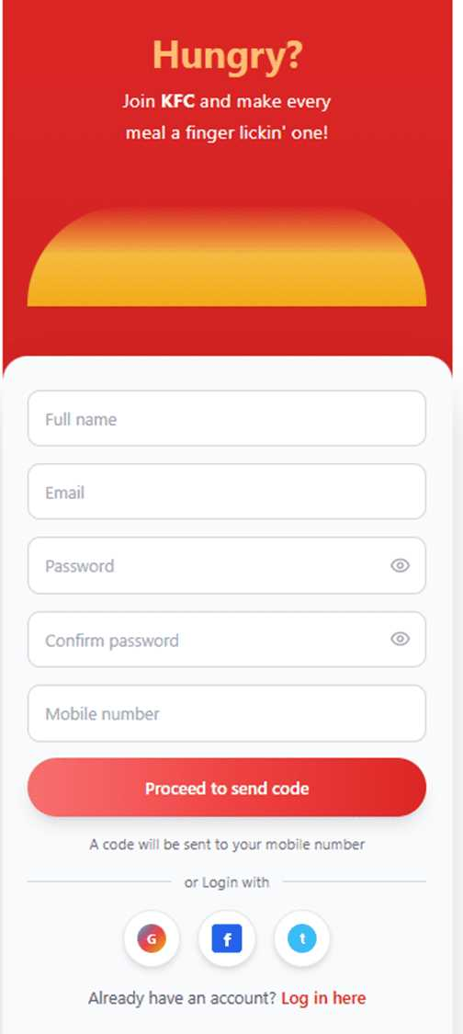
The Create New Account page was limited to name and phone number fields, lacking essential security elements and proper structure.
The redesigned Create New Account page adds email, password, and password confirmation fields to improve account security. A clean, well-organized layout ensures a smoother, more engaging, and more effective registration experience.

Slide 9
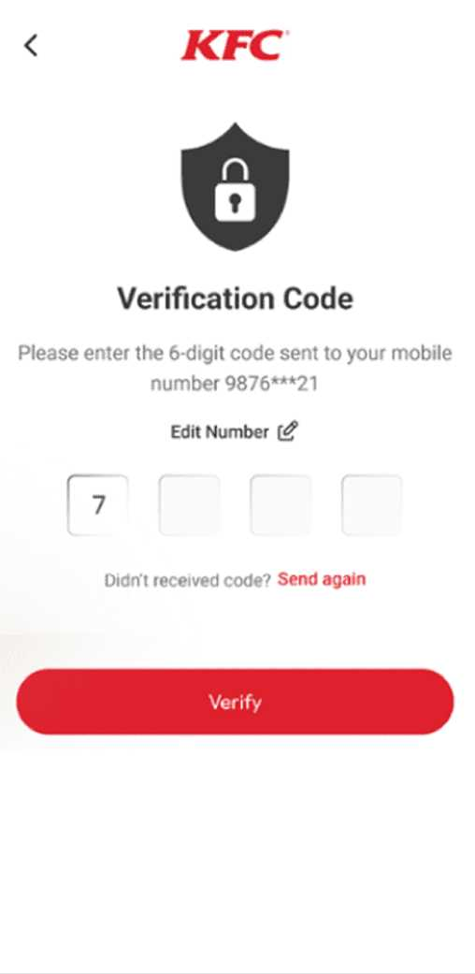
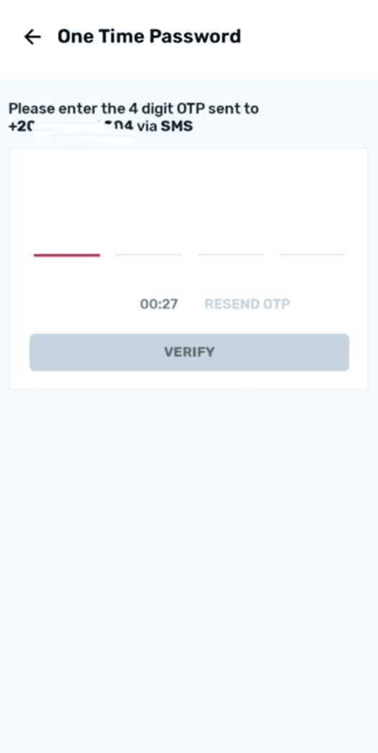
The confirmation page was cluttered, with unclear colors and layout that could lead to mistakes when entering the 4-digit OTP. Key actions like Edit Number and Send Again were not prominent.
The redesign improved colors and layout for better clarity and visual organization, making OTP entry easier and less error-prone. Edit Number and Send Again are now clearly highlighted, ensuring a smoother and safer user experience.

Slide 10
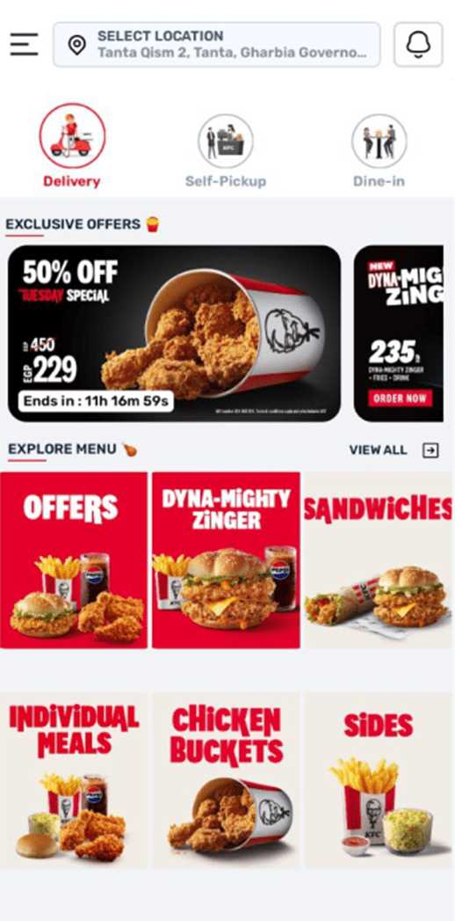
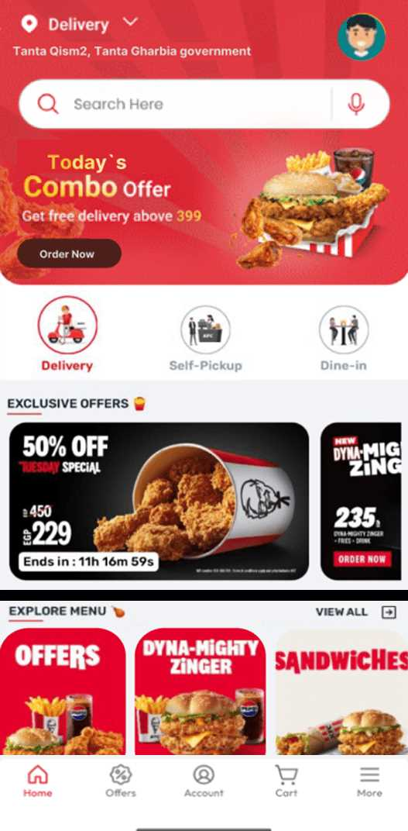
The old home screen design was cluttered and poorly organized, causing user distraction and making product discovery difficult.
The new design adds a bottom navigation bar for quick access to main sections, a clear search bar to speed up finding products, and better visual organization of offers and categories. This results in a cleaner interface and faster decision-making.

Slide 11
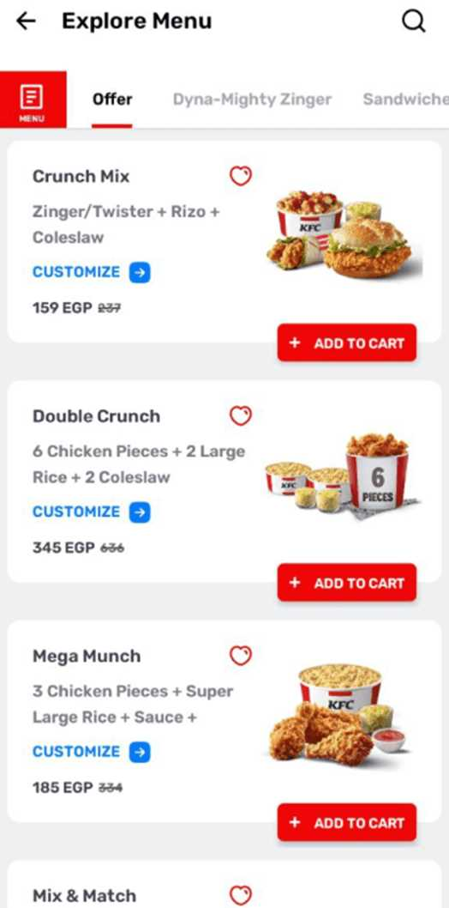
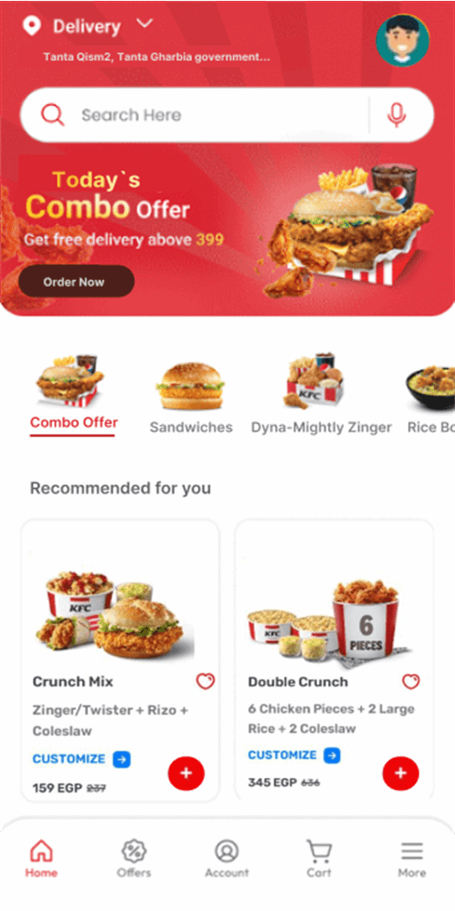
The top sections were plain text, and the meals section was not visually organized, making it less engaging for users.
The top sections now include images to make them more engaging and attention-grabbing. The meals section has been redesigned into organized cards, making browsing easier and visually more appealing.

Slide 12
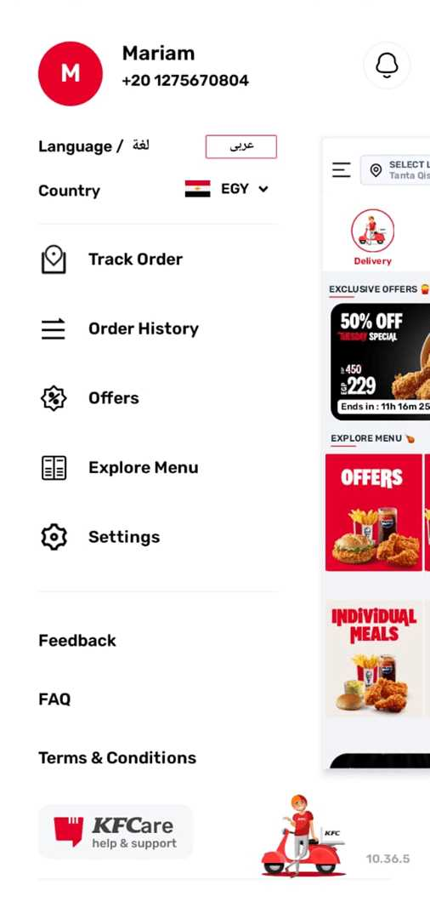
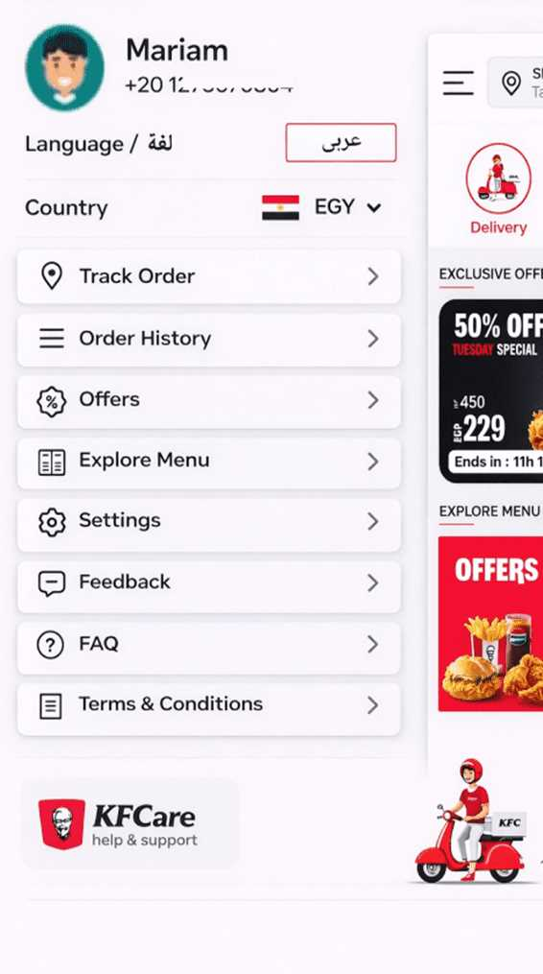
The tabs were scattered, lacked visual organization and clarity, and were combined with inconsistent elements, making it difficult to access user settings and key services.
Tabs such as Order History, Offers, and Addresses are now organized into separate, well-spaced cards with clear icons. This layout makes access to settings and services like support and order tracking easier and more aesthetically pleasing, ensuring a more efficient user experience.

Slide 13
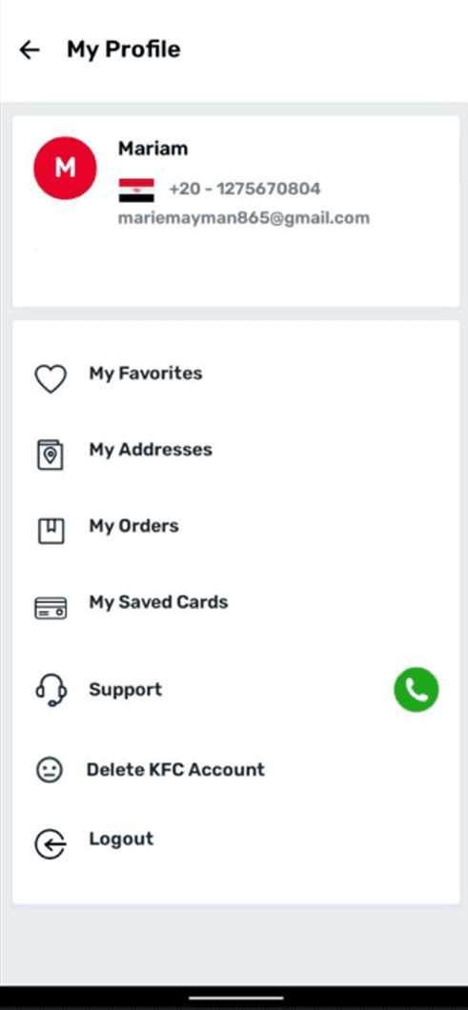
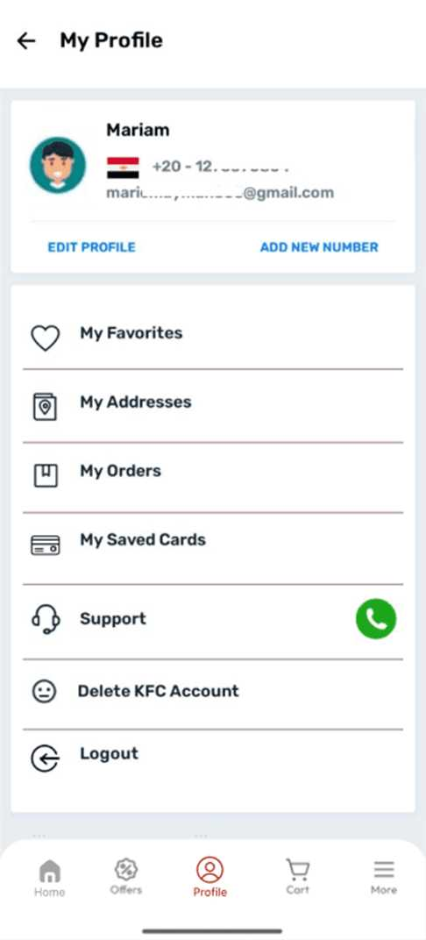
The old page had several issues: there was no option to Edit Number or Add New Number, all fields were presented on the same page without separation, making navigation difficult and cluttered, and there was no profile picture.
The new design added Edit Number and Add New Number options, organized fields with clear separations for better readability and navigation, and included a profile picture to enhance user experience and make the page more appealing and clear.

Slide 14

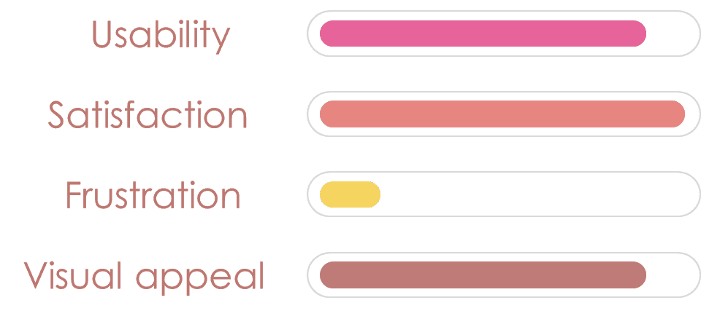

Slide 15
Conclusion
"IN CONCLUSION, THIS NEW DESIGN REPRESENTS A SIGNIFICANT LEAP AIMED AT ELIMINATING USER DISTRACTION AND FRUSTRATION. WE SUCCESSFULLY ELEVATED LEVELS OF USABILITY AND VISUAL APPEAL THROUGH CLEAN, ORGANIZED INTERFACES. THIS FOCUS ON EFFICIENCY AND AESTHETICS ENSURES INCREASED USER SATISFACTION, RESULTING IN A SMOOTHER APP EXPERIENCE AND GREATER COMMERCIAL SUCCESS."
Presented by
SQUAD X TEAM

Slide 16

thanks
Presented by
SQUAD X

